Slide 1
Role of Virtualization in
Distributed Computing
Dr.B.N.Gohil - SVNIT

Slide 2
Birth/History - Virtualization
Intel co-founder Gordon Moore is a visionary. His prediction, popularly known as Moore's Law, states that the number of transistors on a chip will double about every two years. Intel and other semiconductor companies kept that pace for over 40 years.
GPU’s performance and functionality have been increasing at a faster pace than Moore’s law.
Dr.B.N.Gohil - SVNIT

Slide 3
Birth/History - Virtualization
Multi-core: how to fully harness the power of multi-core? Intel has been trying really hard to make us all program for multi-core!!!
Large scale data: How to manage large scale data? Google, Yahoo, NSF and CRA have been promoting their file systems and MapReduce!!
Parallel processing of data: How to configure clusters to process data in parallel?
Answer?
Dr.B.N.Gohil - SVNIT

Slide 4
Birth/History - Virtualization
Technology was initially popularized in 1960’s by IBM.
IBM 370 /VM
1990 VMware released its virtualization product: slow, based on x86 platform (no multi-core), expensive
Now, we have
  VMware suite;
  MS virtual PC, Hypervisor;
  QEMU (Quick Emulator): open source
  XEN
  OpenVZ
  KVM
  VirtualBox
Dr.B.N.Gohil - SVNIT

Slide 5
Virtualization
Virtualization is an abstraction layer that decouples the physical hardware from the operating system to deliver greater IT resource utilization and flexibility.
Creation of a virtual version of hardware using software.
It allows multiple virtual machines, with heterogeneous operating systems to run in isolation, side-by-side on the same physical machine.
Dr.B.N.Gohil - SVNIT

Slide 6
Virtualization
Virtualization is nothing but abstracting operating system, application, storage, network, etc. away from the true underlying hardware or software.
It creates the illusion of physical hardware to achieve the goal of operating system isolation.
In last decade, data centers were occupied by a large number of physical servers, network switches, storage devices. It consumed a lot of power and manpower to maintain the data centers.
Dr.B.N.Gohil - SVNIT

Slide 7
Virtualization
Each virtual machine has its own set of virtual hardware (e.g., RAM, CPU, NIC, etc.) upon which an operating system and applications are loaded.
The operating system creates the illusion of multiple processes, each executing on its own processor with its own (virtual) memory.
Dr.B.N.Gohil - SVNIT

Slide 8
Virtualization
It is the underlying core technology of cloud computing.
It helps in creating a multitenant model for the cloud environment by optimizing the resource usage through sharing.
Dr.B.N.Gohil - SVNIT

Slide 9
Virtualization requirements
By Popek and Goldberg:
  Equivalence: a program running under the VMM should exhibit a behavior essentially identical to that demonstrated when running on an equivalent machine directly;
  Resource control (safety): the VMM must be in complete control of the virtualized resources;
  Efficiency: a statistically dominant fraction of machine instructions must be executed without VMM intervention.
Dr.B.N.Gohil - SVNIT

Slide 10
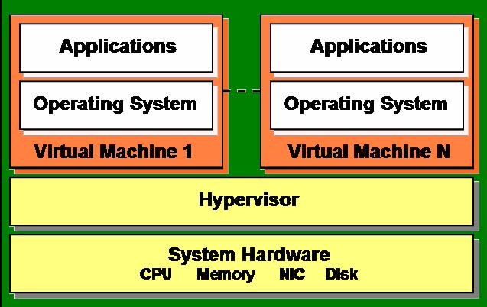
Hypervisor/VMM
Hypervisors are software tools used to create the VMs, and they produce the virtualization of various hardware resources such as CPU, storage, and networking devices.
They are also called virtual machine monitor (VMM) or virtualization managers.
Example - VMware, Xen, Hyper-V, KVM, etc.
Dr.B.N.Gohil - SVNIT

Slide 11
Hypervisor/VMM
Hypervisors help to run multiple OSs concurrently on a physical system sharing its hardware. Thus, a hypervisor allows multiple Oss to share a single hardware host.
The hypervisor also makes sure that the guest OSs (called VMs) do not interrupt each other. It manages multiple OSs or multiple instances of the same OS on a single physical computer system.
Dr.B.N.Gohil - SVNIT

Slide 12
Virtualization vs. Multi-Processing
Process₁
Process₂
∙∙∙
User space/ kernel separation
OS
HW interface
HW (disk, NIC,…)
Multi-processing
Pr₁
Pr₂
Pr₁
Pr₂
∙∙∙
VM
OS₁
OS₂
∙∙∙
Virtual HW interface
VMM/Hypervisor
Virtualization
Real HW interface
HW (disk, NIC,…)
Dr.B.N.Gohil - SVNIT

Slide 13


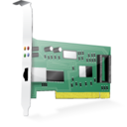

Server without Virtualization
Hardware
CPU Memory NIC DISK
Only one OS can run at a time within a server.
Under utilization of resources.
Inflexible and costly infrastructure.
Hardware changes require manual effort and access to the physical server.
Operating System
Multiple Software Applications
Dr.B.N.Gohil - SVNIT

Slide 14



Server with Virtualization
Hardware
CPU Memory NIC DISK
Hypervisor
Can run multiple OS simultaneously.
Each OS can have different hardware configuration.
Efficient utilization of hardware resources.
Each virtual machine is independent.
Save electricity, initial cost to buy servers, space etc.
Easy to manage and monitor virtual machines centrally.
Virtual Server 1
Virtual Server 2
Operating System
Operating System
Multiple Software Applications
Multiple Software Applications
Dr.B.N.Gohil - SVNIT

Slide 15



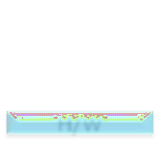



Without Virtualization…
Waste of Resources
85%
85%
85%
85%
Maximum
Utilization
15% App | 15% App | 15% App | 15% App
OS | OS | OS | OS
(Linux) | (Linux) | (Windows) | (Windows)
H/W | H/W | H/W | H/W
HR | Marketing | Finance | IT
Total
Capacity
100%
100%
100%
100%
*ref-cleanclouds
Dr.B.N.Gohil - SVNIT

Slide 16

With Virtualization…
Utilization of single PM
60%
15% App | 15% App | 15% App | 15% App
OS | OS | OS | OS
(Linux) | (Linux) | (Windows) | (Windows)
H/W | H/W | H/W | H/W
HR | Marketing | Finance | IT
Virtual
Machines
(VMs)
Middleware / Virtual Machine Monitor (VMM) / Hypervisor#
Hardware
Total Capacity
100%
#A hypervisor is a small software layer that enables multiple operating systems to run alongside each other, sharing the same physical computing resources.
*ref-cleanclouds
Dr.B.N.Gohil - SVNIT

Slide 17
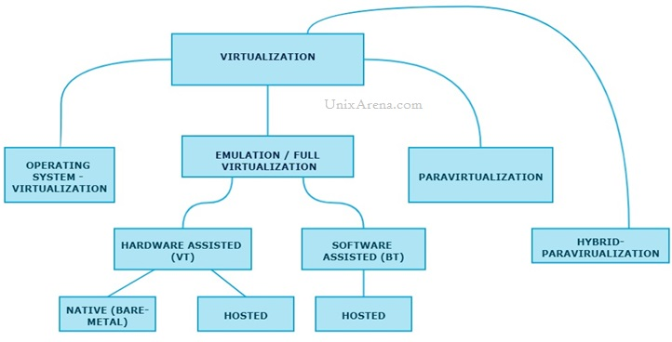
Techniques of Virtualization
Dr.B.N.Gohil - SVNIT

Slide 18
Full Virtualization
Virtual machine simulates hardware to allow an unmodified guest OS to be run in isolation.
Full virtualization uses a special kind of software called a hypervisor.
The hypervisor interacts directly with the physical server’s hardware resources, such as the CPU and storage space, and acts as a platform for the virtual server’s OSs. It helps to keep each virtual server completely independent and unaware of the other virtual servers running on the physical machine.
Each guest server or the virtual machine (VM) is able to run its own OS. That means one virtual server could be running on Linux and the other one could be running on Windows.
Dr.B.N.Gohil - SVNIT

Slide 19
Full Virtualization
There is two type of Full virtualizations in the enterprise market. On both full virtualization types, guest operating system’s source information will not be modified.
- Software assisted full virtualization
- Hardware-assisted full virtualization
Examples include VMWare ESX and VirtualBox.
Advantages - isolation among the various VMs, isolation between the VMs and the hypervisor, concurrent execution of multiple OSs, and no change required in the guest OS.
Disadvantage - the overall system performance may be affected due to binary translation.
Dr.B.N.Gohil - SVNIT

Slide 20
CPU Protection Rings
Level-3
Lowest
privilege
Level-2
Level-1
OS kernel
Level -0
Highest
privilege
OS services
(device driver, etc.)
Applications
Dr.B.N.Gohil - SVNIT

Slide 21
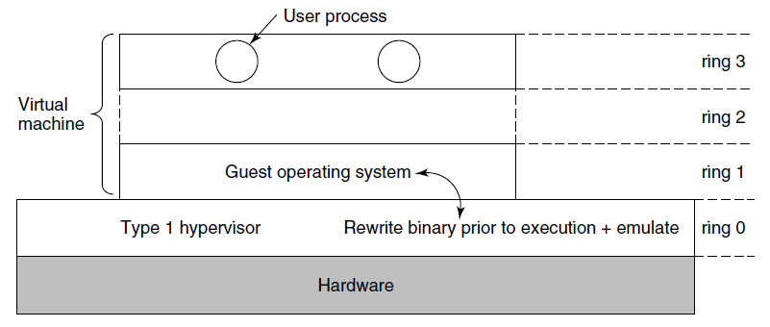
Binary Translation
Kernel code of non-virtualizable instructions are translated to replace with new sequences of instructions that have the intended effect on the virtual hardware
Ring 3
Application
Direct
Execution
of user and OS
Requests
Ring 2
Ring 1
Guest OS
Ring 0
VMM
Binary translation
of OS Requests
Hardware
Dr.B.N.Gohil - SVNIT

Slide 22
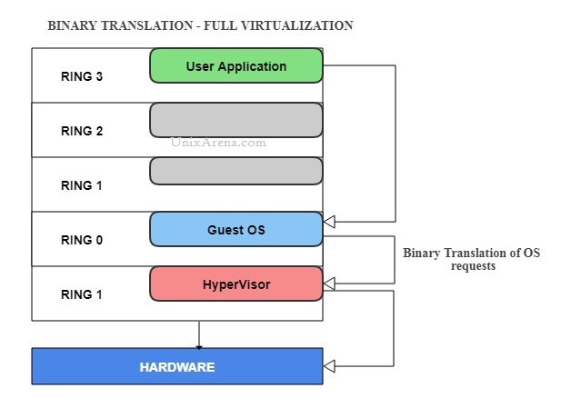
Software Assisted FV
It completely relies on binary translation to trap and virtualize the execution of sensitive, non-virtualizable instructions sets.
It emulates the hardware using the software instruction sets.
Due to binary translation, it often criticized for performance issue.
Example: VMware workstation, Virtual PC, VirtualBox, VMware Server
Ring 3
Application
Direct
Execution
of user and OS
Requests
Ring 2
Ring 1
Guest OS
Binary translation
of OS Requests
Ring 0
VMM
Hardware
Dr.B.N.Gohil - SVNIT

Slide 23
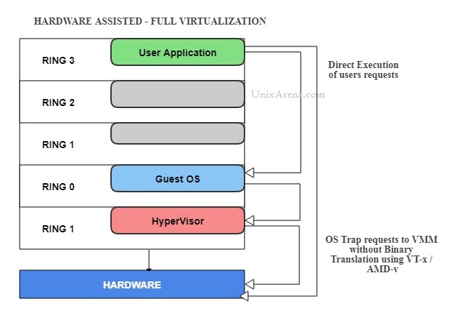
Hardware Assisted FV
Privileged and sensitive calls are set to automatically trap to the hypervisor, removing the need for either binary translation or paravirtualization using the virtualization technology which has been integrated on X86 processors since 2005 (Intel VT-x and AMD-V).
Guest OS’s instructions might allow a virtual context execute privileged instructions directly on the processor, even though it is virtualized.
Example(bare metal – type 1): Vmware ESXi/ESX, KVM, Hyper-V, Xen
Example(hosted – type 2): Vmware, Vrtual Box
Dr.B.N.Gohil - SVNIT

Slide 24
Hardware Assisted FV
Ring 3
Application
Direct
Execution
of user and OS
Requests
Ring 2
Non-root
Mode
Privilege
Levels
Ring 1
Ring 0
Guest OS
VMM
OS requests traps
to VMM without
binary translation
or paravirtualization
Root Mode
Privilege
Levels
Hardware
Dr.B.N.Gohil - SVNIT

Slide 25
Para-virtualization
  Also know as OS assisted virtualization
  Possible using an modified OS kernel as guest OS
  It is very difficult to build the more sophisticated binary translation support necessary for full virtualization.
  Paravirtualization involves modifying the OS kernel to replace non-virtualizable instructions with hypercalls that communicate directly with the virtualization layer hypervisor.
  The hypervisor also provides hypercall interfaces for other critical kernel operations such as memory management, interrupt handling and time keeping.
  Paravirtualization is different from full virtualization, where the unmodified OS does not know it is virtualized and sensitive OS calls are trapped using binary translation.
  Paravirtualization cannot support unmodified OS
Dr.B.N.Gohil - SVNIT

Slide 26
Para-virtualization
VMs do not simulate the underlying hardware, but with the modified guest OS, API is used.
Example – Xen, VMWare ESX server, IBM LPAR, Oracle VM
Here, the guest OS is aware of the fact that it is running in a virtualized environment.
Hypercalls are used for the direct communication between the guest OS and the hypervisor.
Advantage - it improves the overall system performance by eliminating the overhead of binary translation.
Disadvantage - modification of the guest OS is required.
Dr.B.N.Gohil - SVNIT

Slide 27

Comparison
 | Full Virtualization with Binary Translation | Hardware Assisted Virtualization | OS Assisted Virtualization / Paravirtualization
Technique | Binary Translation and Direct Execution | Exit to Root Mode on Privileged Instructions | Hypercalls
Guest Modification / Compatibility | Unmodified Guest OS Excellent compatibility | Unmodified Guest OS Excellent compatibility | Guest OS codified to issue Hypercalls so it can't run on Native Hardware or other Hypervisors Poor compatibility; Not available on Windows OSes
Performance | Good | Fair Current performance lags Binary Translation virtualization on various workloads but will improve over time | Better in certain cases
Used By | VMware, Microsoft, Parallels | VMware, Microsoft, Parallels, Xen | VMware, Xen
Guest OS Hypervisor Independent? | yes | yes | XenLinux runs only on Xen Hypervisor VMI-Linux is Hypervisor agnostic
Dr.B.N.Gohil - SVNIT

Slide 28
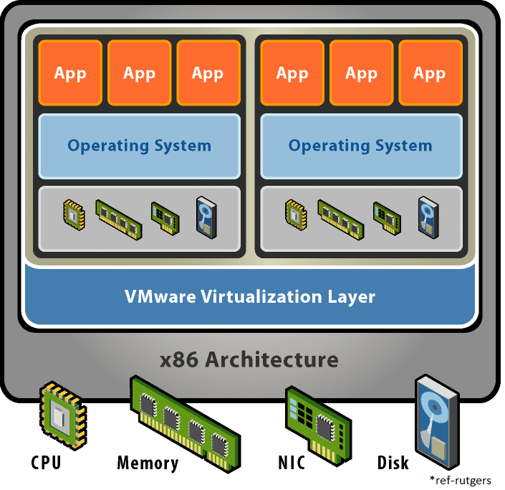
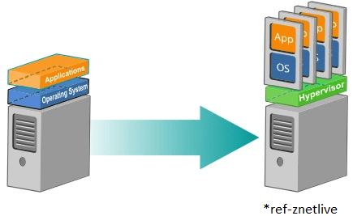
Hypervisor/VMM
A Hypervisor or Virtual Machine Monitor(VMM) is computer software, firmware or hardware that creates and runs virtual machines.
The way to achieve virtualization
Allows multiple OSs to share single hardware machine
Dr.B.N.Gohil - SVNIT

Slide 29
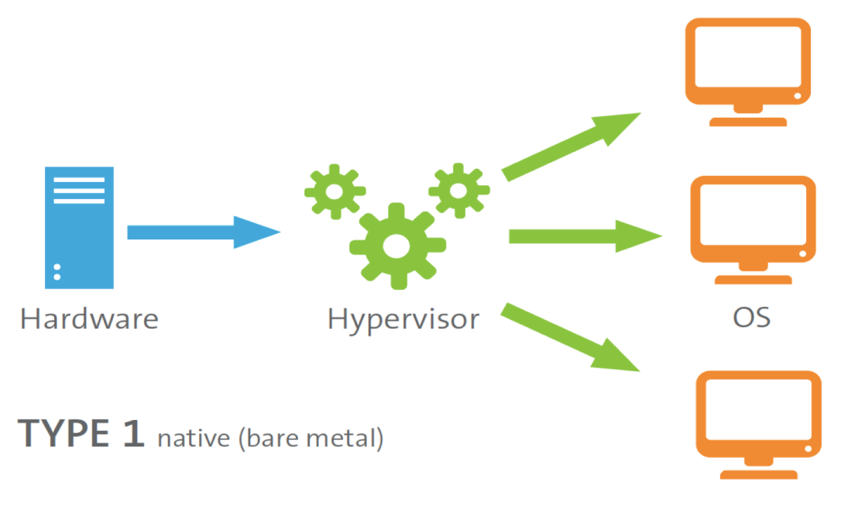
Type 1/ Bare Metal Hypervisor
This type of hypervisor runs directly on the host computer’s hardware in order to control the hardware resources and also to manage the guest OSs.
This is also known as native or bare-metal hypervisors.
Dr.B.N.Gohil - SVNIT

Slide 30
Type 1/ Bare Metal Hypervisor
VM
VM
VM
Runs directly on the system hardware.
May require hardware assisted virtualization technology support by the CPU.
Limited set of hardware drivers provided by the hypervisor vendor.
E.g.: Xen, VMware ESXi, Citrix XenServer, and Microsoft Hyper-V hypervisor.
Hypervisor
Kernel Driver
Hardware
Dr.B.N.Gohil - SVNIT

Slide 31
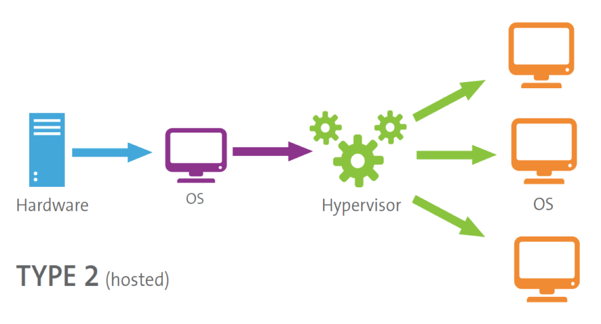
Type 2/ Hosted Hypervisor
This type of hypervisor runs within a formal OS environment as a distinct second layer while the guest OS runs as a third layer above the hardware.
This is also known as the hosted hypervisors.
Dr.B.N.Gohil - SVNIT

Slide 32
Type 2/ Hosted Hypervisor
VM
VM
Applications
Runs virtual machines on top of a host OS (windows, Unix etc.)
Relies on host OS for physical resource management.
Host operating system provides drivers for communicating with the server hardware.
E.g.: VirtualBox, VMware Workstation
Hypervisor
Host Operating System
Hardware
Dr.B.N.Gohil - SVNIT

Slide 33
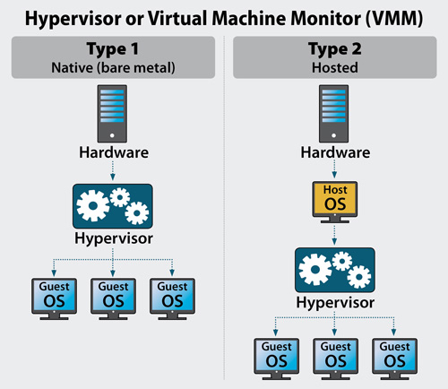
Type 1 Vs Type 2 Hypervisors
Dr.B.N.Gohil - SVNIT

Slide 34
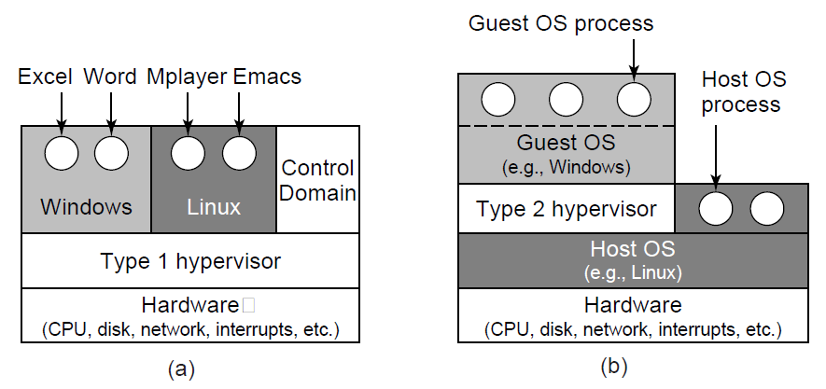
Type 1 Vs Type 2 Hypervisors
Example: VMware ESX, Microsoft Hyper-V, Xen
Example: VMware Workstation, Microsoft Virtual PC, Sun VirtualBox, QEMU, KVM
Dr.B.N.Gohil - SVNIT

Slide 35
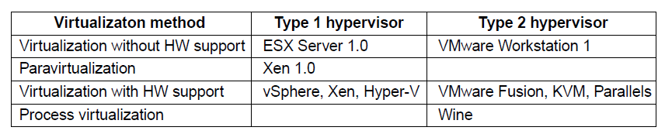
Type 1 Vs Type 2 Hypervisors
Dr.B.N.Gohil - SVNIT

Slide 36


Architecture of VMWare ESXi
Hardware
Bare Metal Approach
Full virtualization
Used for secure and robust virtualization solutions for virtual data centers and cloud infrastructures
Takes advantage of support for hardware assisted virtualization for 64-bit OS on Intel processors.
VM
VM
VM
Hypervisor
Dr.B.N.Gohil - SVNIT

Slide 37

Architecture of Xen
Hardware
Open source; bare metal.
Offers both Hardware Assisted Virtualization (HVM) and Para-Virtualization (PV)
Needs virtualization support in the CPU for HVM.
Xen loads an initial OS which runs as a privileged guest called “domain 0”.
The domain 0 OS, typically a Linux or UNIX variant, can talk directly to the system hardware (whereas the other guests cannot) and also talk directly to the hypervisor itself. It allocates and maps hardware resources for other guest domains.
Domain Zero Guest
VM
VM
Hypervisor
Dr.B.N.Gohil - SVNIT

Slide 38
KVM
Hardware
Kernel based virtual machine (Kernel Based VM)
Open source and Full virtualization
Kernel-level extension to Linux.
Supports full virtualization and hence does not need hardware assisted virtualization support in the CPU.
1. Linux Applications
2. KVM Management
Console
VM
VM
Linux
Linux Kernel
KVM
Dr.B.N.Gohil - SVNIT

Slide 39
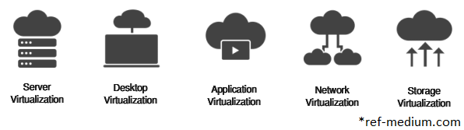
Types of Virtualization
Depending on the resources virtualized, the process of virtualization can be classified into the following types.
OS virtualization - The kernel of an operating system allows more than one isolated user-space instances to exist.
Hardware/Server virtualization – creates VMs in single server.
Memory virtualization -decouples memory from the server to provide a shared, distributed or networked function.
Dr.B.N.Gohil - SVNIT

Slide 40
Types of Virtualization
Storage virtualization - multiple network storage resources are present as a single storage device for easier and more efficient management of these resources
Network virtualization - process of combining hardware and software network resources and network functionality into a single, software-based administrative entity.
Application virtualization/Containerization - encapsulates computer programs from the underlying operating system on which they are executed - “single executable and run anywhere” / “Sandbox”
Desktop virtualization – also known as VDI, will run as VM on physical server along with other VDIs. Example – Citrix Xen, VMWare Horizon
Dr.B.N.Gohil - SVNIT

Slide 41
Memory Virtualization
VM1
VM2
Process 1
Process 2
Process 1
Process 2
Virtual memory
Physical memory
Machine memory
Dr.B.N.Gohil - SVNIT

Slide 42
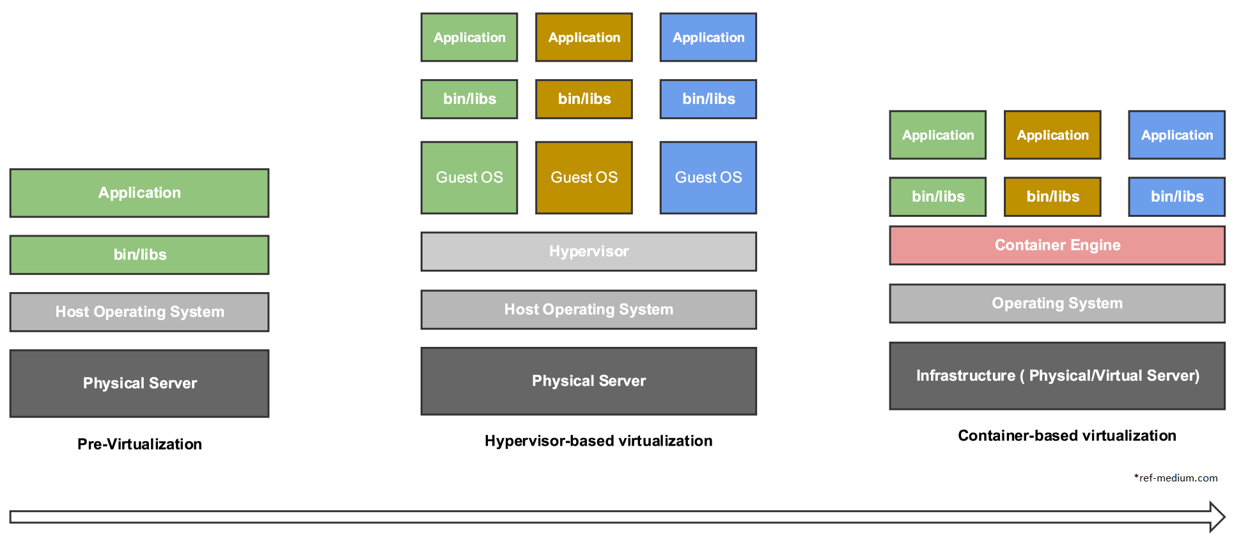
Evolution of Virtualization
Dr.B.N.Gohil - SVNIT

Slide 43
Advantages
Cost-effectiveness – less hardware
  Multiple virtual machines / operating systems /
  services on single physical machine (server consolidation)
  Various forms of computation as a service
Isolation
  Good for security
  Great for reliability and recovery: If VM crashes it can be rebooted, does not affect other services (fault containment)
  VM migration
  Safe for “untrusted” applications.
  Partitioning of Services
    Server Environment more stable.
    Some Applications don’t play w/ Others
Dr.B.N.Gohil - SVNIT

Slide 44
Advantages
Development tool
  Work on multiple OS in parallel
  Develop and debug OS in user mode
Multi-Platform Testing
  Only need one set of Hardware
    Resource saver on purchases (time/money)
    Can cut setup time
Emulated Hardware
  Same Hardware on All Test Environments
  Hardware Simulation
  Limited Resource Environments
Encapsulation
  One VM → One File/Folder on Disk
  Typically easy to migrate.
Dr.B.N.Gohil - SVNIT

Slide 45
Advantages
Migration from one machine to another
Disaster recovery
Energy optimization
OS Debugging
  Crash on Developing OS do not (typically) affect Host OS.
  Debug
    Memory dumps/ CPU Registers/ Serial / Parallel Port dumps
Legacy Applications
Virtualization is Fun!
  Gain Experience with new OS.
  Help a business transition to Open-Source.
Dr.B.N.Gohil - SVNIT

